Slide 1


Teapots Can Fly
#GHC13
3D Graphics for Web Programmers
Kelley Nielsen
Salticid Software, Codechix
October 4, 2013
2013

Slide 2
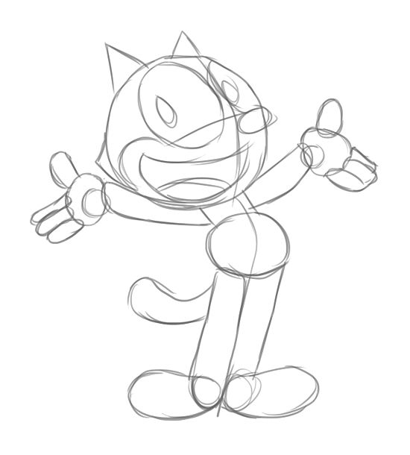
So…
How does
3D
Animation
Work?

Slide 3
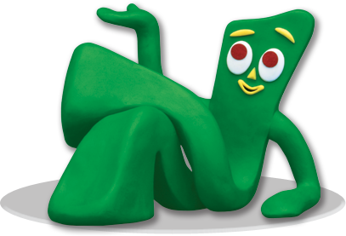
3D animation is like Claymation

Slide 4
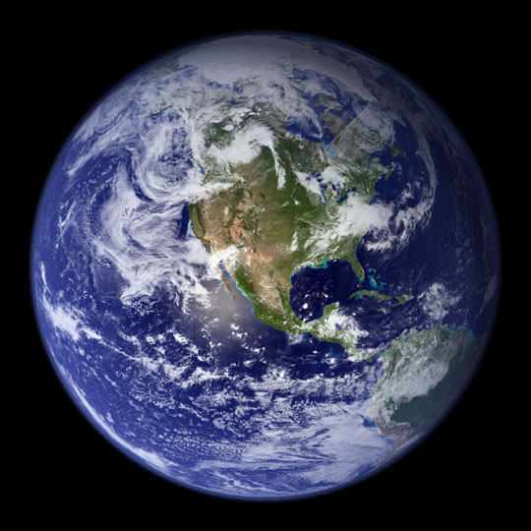
We’re building
Our own little world

Slide 5
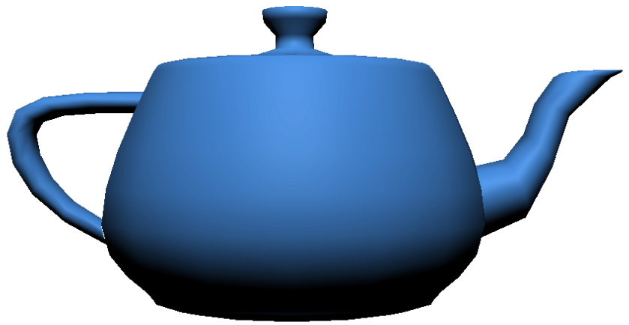
Three orienting questions
Where?
What?
How?

Slide 6
Three orienting questions
Where?
Three.scene
Three.PerspectiveCamera

Slide 7
Three orienting questions
Three.Mesh
What?
Three.PointLight

Slide 8
Three orienting questions
requestAnimationFrame()
Affine transformations:
translate, rotate, scale
How?

Slide 9
What do we need?
three.js
teapot.js
An html5 page

Slide 10
To get it all:
https://github.com/shegeek/
teapots_can_fly
clone or download zip

Slide 11
The basic setup
<head>
<title>Teapots can fly!<title>
<style>canvas { width: 100%;
Height: 100% }
</style>
</head>

Slide 12
The basic setup
<body>
<script src="three.min.js">
</script>
<script>
** Our Stuff Goes Here! **
</script>
</body>

Slide 13
The last setup step
<script>
var renderer = new THREE.WebGLRenderer();
renderer.setSize(window.innerWidth,
window.innerHeight);
document.body.appendChild
(renderer.domElement);
</script>

Slide 14
And now,
the
3D code!

Slide 15
Three orienting questions
Where?
Three.scene
Three.PerspectiveCamera

Slide 16
The diorama
var scene = new THREE.Scene();

Slide 17
The Camera
var camera = new THREE.PerspectiveCamera(
35,
window.innerWidth/window.innerHeight,
0.1, 1000);
camera.position.z = 50;

Slide 18
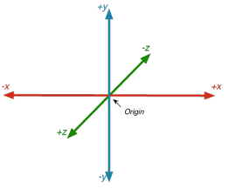
The coordinate system
Right-handed coordinates
Positive X to the right
Positive Z coming out
of the screen

Slide 19
Three orienting questions
Three.Mesh
What?
Three.PointLight

Slide 20
The teapot
var teapot;
var jsonLoader = new THREE.JSONLoader();
jsonLoader.load( "teapot.js", createTeapot);

Slide 21
The teapot’s callback
function createTeapot(tGeometry){
var tMaterial = new
THREE.MeshPhongMaterial({color: 0x00ffff});
var tMesh = new
THREE.Mesh(tGeometry, tMaterial);
scene.add(tMesh);
teapot = tMesh;
}

Slide 22
A closer look…
new THREE.Mesh( tGeometry, tMaterial );
A mesh has two parts

Slide 23
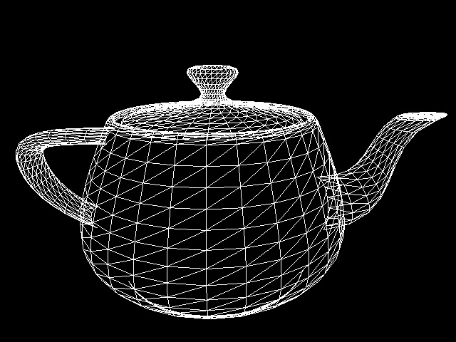
A geometry is like bones

Slide 24
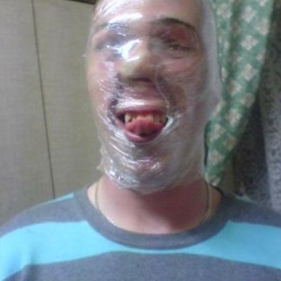
A material is like skin

Slide 25
The teapot’s callback
function createTeapot(tGeometry){
var tMaterial = new
THREE.MeshPhongMaterial({color: 0x00ffff});
var tMesh = new
THREE.Mesh(tGeometry, tMaterial);
scene.add(tMesh);
teapot = tMesh;
}

Slide 26
Let there be light!
var light = new THREE.PointLight(0xffffff);
light.position.set(0,150,150);
scene.add(light);

Slide 27
Three orienting questions
requestAnimationFrame()
Affine transformations:
translate, rotate, scale
How?

Slide 28
Making the teapot move
teapot.position.x += 0.1;
if (teapot.position.x > halfScreenWidth)
teapot.position.x = -halfScreenWidth;

Slide 29
Rendering the frame
renderer.render(scene, camera);

Slide 30
Setting up the next frame
requestAnimationFrame(render);

Slide 31
The complete render loop
var halfScreenWidth = 80;
var render = function () {
if (teapot) {
teapot.position.x += 0.1;
if (teapot.position.x > halfScreenWidth)
teapot.position.x = -halfScreenWidth;
renderer.render(scene, camera);
}
requestAnimationFrame(render);
};
render();

Slide 32

…And once again, the repo:
https://github.com/shegeek/teapots_can_fly
Enjoy! Make cool stuff!
kelleynnn@gmail.com

Slide 33

Got Feedback?
Rate and Review the session using the GHC Mobile App
To download visit www.gracehopper.org
Notes:
This is the last slide and must be included in the slide deck

Slide 34
Resources and links
three.js repo: https://github.com/mrdoob/three.js
three.js home page: http://threejs.org/
Stemkoski's examples:
http://stemkoski.github.io/Three.js/index.html
WebGL Up and Running (by Tony Parisi):
http://shop.oreilly.com/product/0636920024729.do
Learning Three.js blog: http://learningthreejs.com/

Slide 35
Resources and links
three.js boilerplate builder:
http://jeromeetienne.github.io/threejsboilerplatebuilder/
An Introduction to Web GL:
http://dev.opera.com/articles/view/an-introduction-towebgl/
Tutorials on the LearningWebGL blog:
http://learningwebgl.com/blog/?page_id=1217
WebGL 1.0 spec: http://www.khronos.org/webgl/

Slide 36
Image credits
Felix image courtesy of Wikihow
wikihow.com/Draw-Felix-the-Cat
Gumby image courtesy of Art Clokey's Gumbyworld
gumbyworld.com
Earth image courtesy of NASA visibleearth.nasa.gov
Coordinate axes image courtesy of
http://www.cocos2d-x.org/
Teapot wireframe image courtesy of
caig.cs.nctu.edu.tw/
Saran Wrap man image courtesy of
funnyordie.com

Slide 37
Teapots Can Fly
Kelley Nielsen
San Jose, CA
1-831-295-1219
kelleynnn@gmail.com

